Slide 1


Everything revolves around her
PLUS FILE

Slide 2

Read the sentences. What do they mean? Express your opinion.
There is no such thing as a perfect family.
All families have their ups and downs.

Slide 3
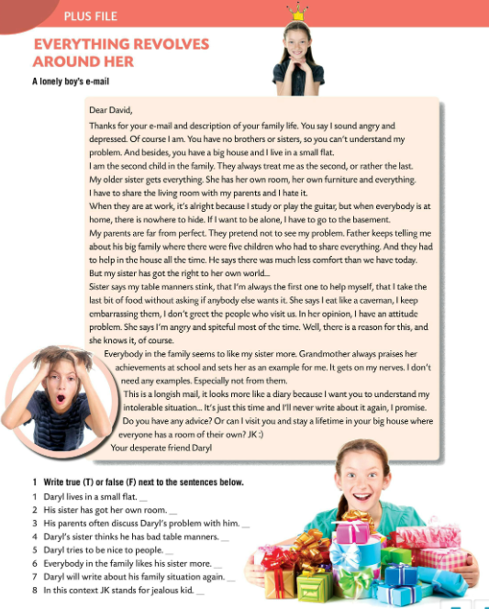
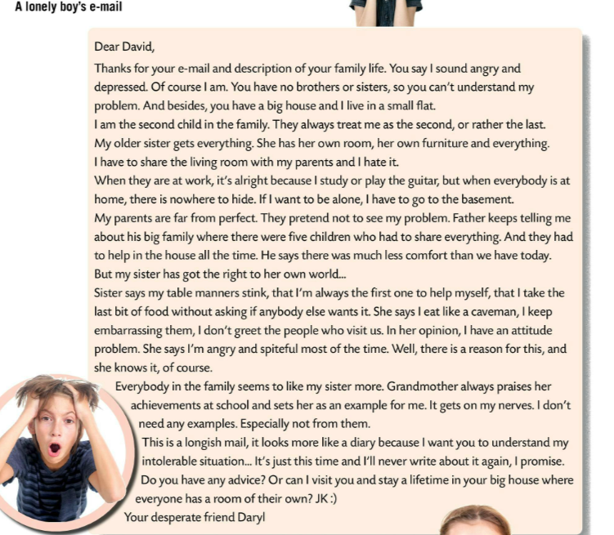
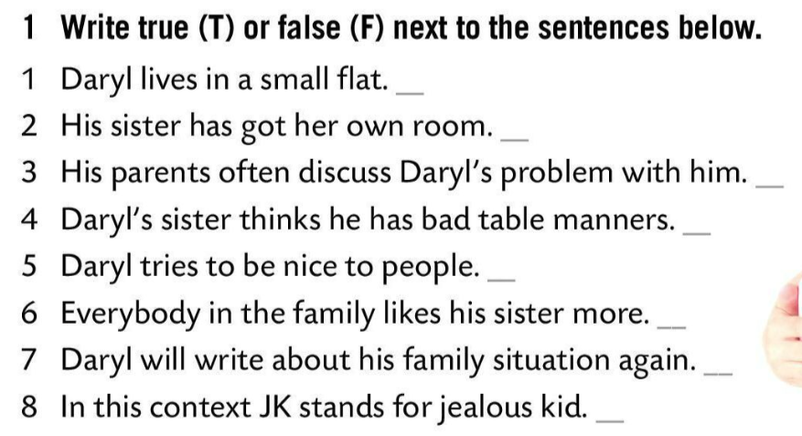
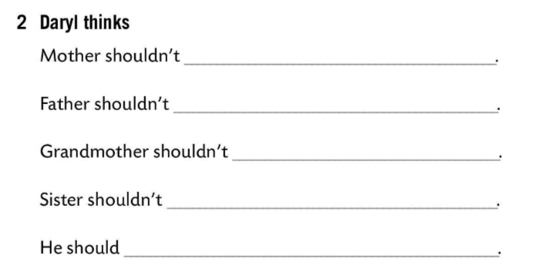
Read a lonely boy’s e-mail.
Write true (T) or false (F) next to the sentences below.
T
pretend not to see his problem.
Check.
T
always talk about his difficult childhood.
F
Rewrite incorrect sentences. Make them correct.
T
praise his sister.
F
criticize his manners.
T
get his own room.
F
Read the text again.
F
Finish the sentences.
Check.

Slide 4
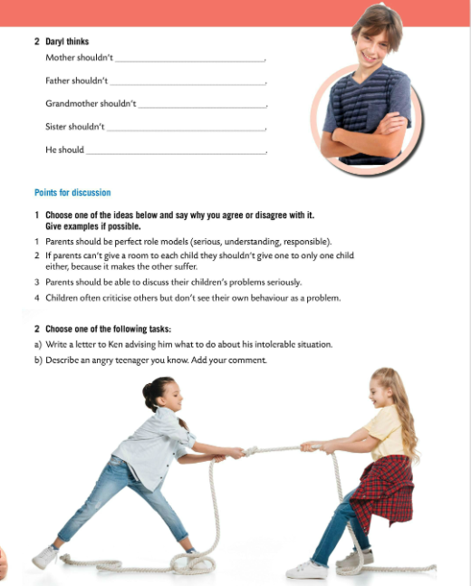
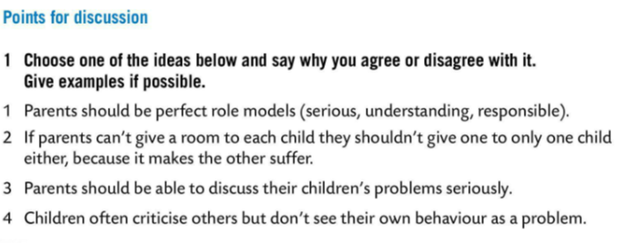
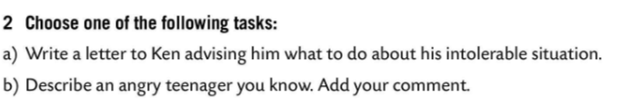

Choose one of the ideas below and say why you agree or disagree with it. Give examples if possible.
Choose one of the following tasks.
Work in pairs. Think of a similar situation and give advice.

